Slide 1
Explosive joining of dissimilar metals: experiment and numerical modeling
Anan’ev S.Yu., Andreev A.V., Deribas A.A., Yankovskiy B.D.
Joint Institute for high temperatures,
Moscow, Russia

Slide 2
Methods of research realization:
The task of the shock-wave welding:
Formation of the metal joining due to plastic deformation without fusion.
Mathematical modeling has for an object to determine plastic deformation and residual strength in different sites of a contact surface of cylinders depending on conditions of pulse loading.
Experiments are directed onto making of various types of metal contacts produced under different conditions of loading.

Slide 3
The schemes of shock-wave loading of cylinders:
Loading intensity must be sufficient for formation of strong connection in contact at absence of deformation of the form and destruction of free surfaces of details. Variability of schemes may be provided with a variety of geometry and intensity of explosion loading. Special requirements arise thus to the form, the sizes, weight and density of a HE charge. We used powder RDX as explosive which possesses a big energy capacity and ability to a detonation at small cross sections of a charge and good adaptability at formation of a charge also.

Slide 4
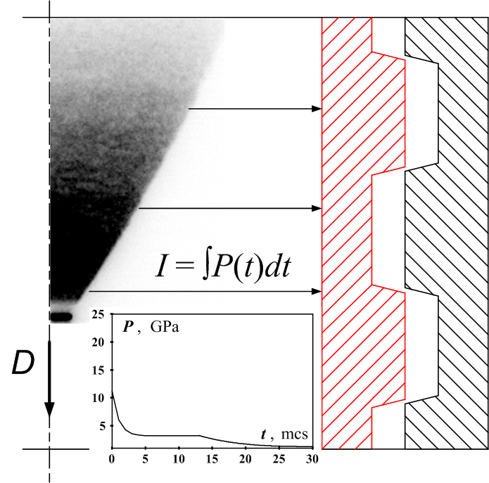

The schemes of shock-wave loading of cylinders
Fig. 1. Geometry of cylinders assembly with thread surfaces in the beginning of computing process

Slide 5
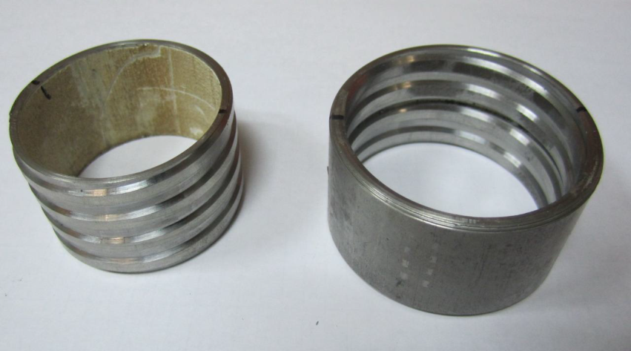
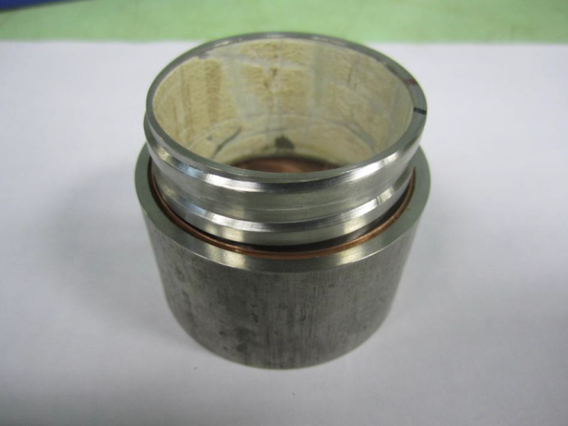
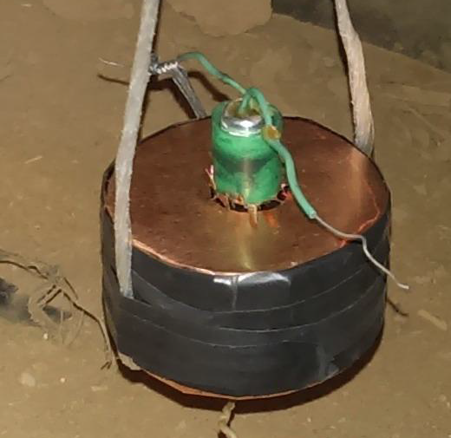
The photos of explosive assemblies:
Parameters of explosive assemblies:
Soft and stainless steel cylinders were using in experiments. Thickness of walls of cylinders was equal to 4 mm. Diameter of a contact surface was equal to 48 mm. Trapezoidal screw threads have been cut on contact surfaces of both cylinders.
Threads had a pitch of 8 mm and depth of cutting of 0,5-1,0 mm. The middle width of a screw thread was equal to 4 mm. An axial positions of a cylindrical HE charges were using in the base of technique of loading of cylinders. Diameter of HE charge had changes in a range of 8-15 mm. The volume between HE charge and steel cylinders was filled by damping materials. Air, water, sand or steel shell was applied in quality of materials of a bandage of the outer cylinder.

Slide 6
Parameters of wave loading:
Intensity of loading in a range of pressure 0,1-12 GPa had been varied by type of a damp material. Pressure of loading of 12 GPa had been received at placing of an explosive tube (a thickness of the wall is equal to 1,5-3 mm) directly in contact with an internal surface of the steel cylinder. Duration of loading 20-50 µs had been defined by time of the expiration of detonation products from initial volume of a HE charge

Slide 7
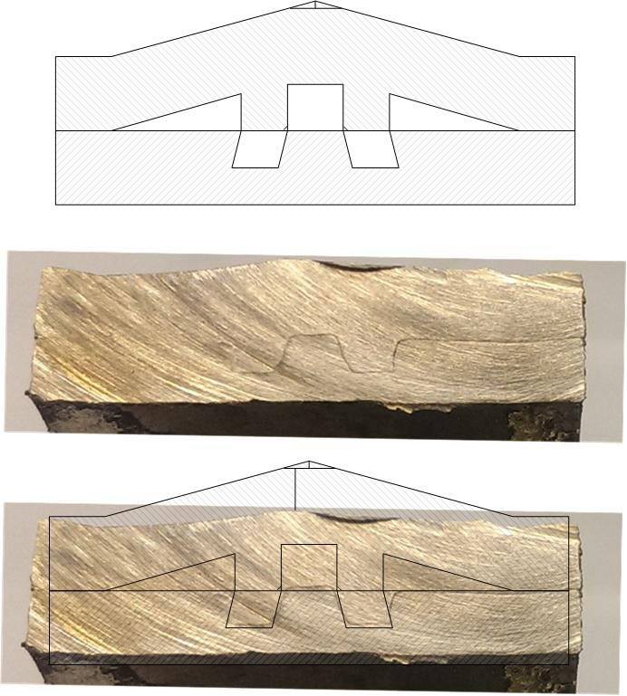
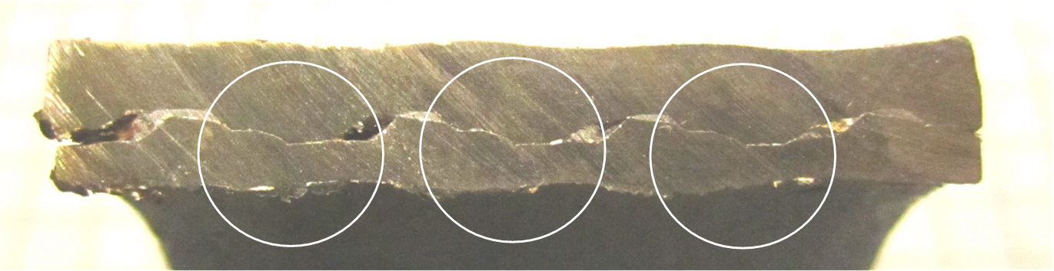
Experimental results
Photo of contact deformation on surface of cylinders after explosion loading.
The trapezoidal screw threads of cylinders had initial axial displacement

Slide 8
Mathematical modeling:
Mathematical modeling of formation process for explosion connection is carried out in frame of solid mechanics. The ABAQUS EXPLICIT module from SIMULIA ABAQUS software package for finite element analysis is used for calculation of fast deformation process of metals. The module has the comprehensive facilities for calculation of contact interactions and for modeling of physically and geometrically nonlinear processes during materials deformation.

Slide 9
Mathematical modeling:
Lagrange-Euler continuous mesh refinement (ALE adaptive meshing) was used for reaching of solution convergence when fast intensive deformation and non-uniform contact interaction have place. The characteristic size of finite elements was equal 50 µm that corresponds to the size of metal grain

Slide 10
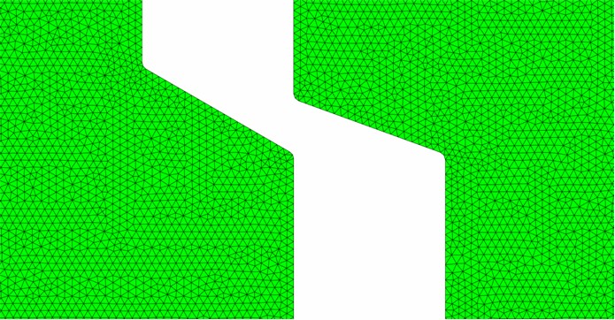
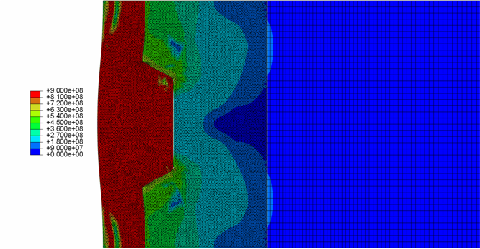
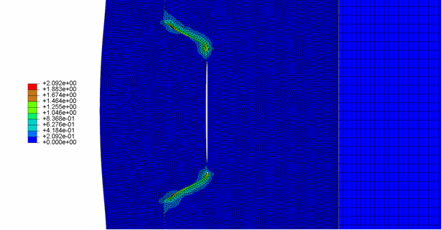
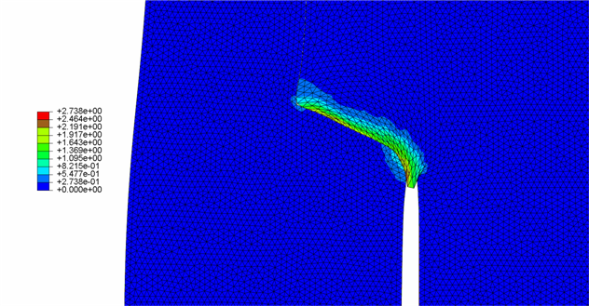
Modeling results
The initial state
Mises stress, Pa
Equivalent plastic strain
Flowing of material into the gap

Slide 11
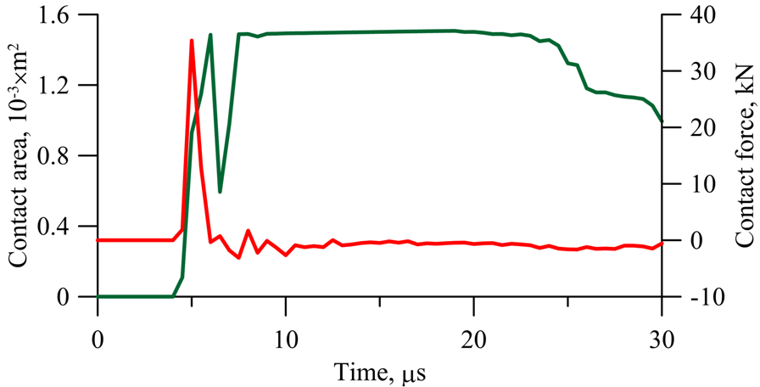
Modeling results
Dependence of the overall contact area (green curve) and total force on a contact surface (red curve) vs time

Slide 12
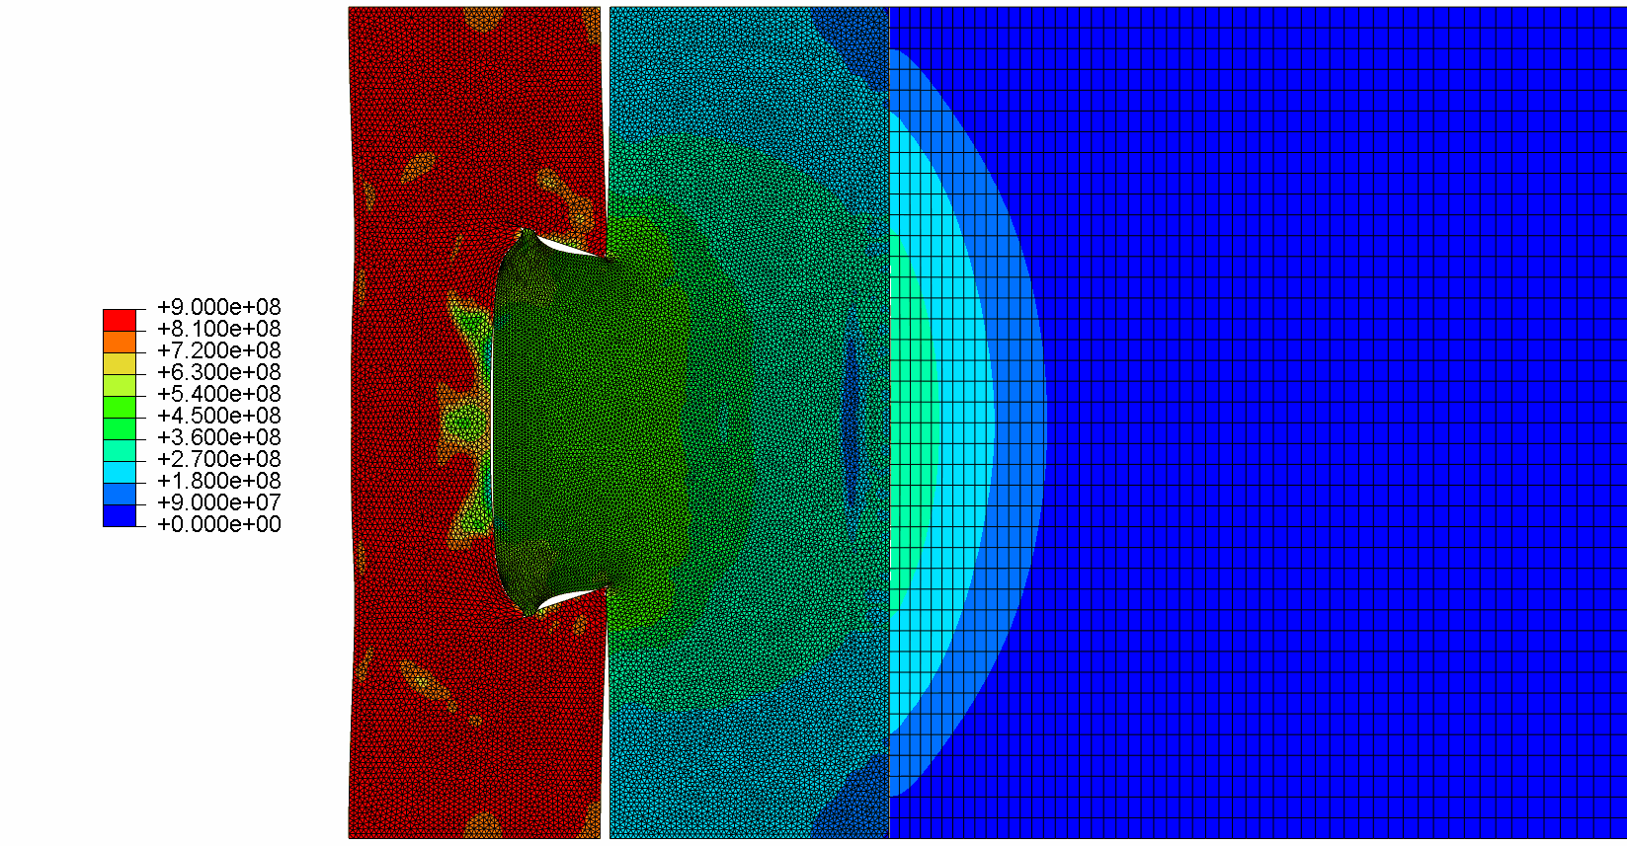
Modeling results
Flowing of material into the gap

Slide 13
Resume
An opportunity of realization of residual intense condition in the field of explosive connection of the diverse metals had been researched. It was shown that a keeping of significant pressure difference along a contact zone may be provided.
The work at the given stage is directed at optimization of geometrical parameters of a contact surface of cylinders from the point of view of efficiency of shock loading for residual strength.

Slide 14
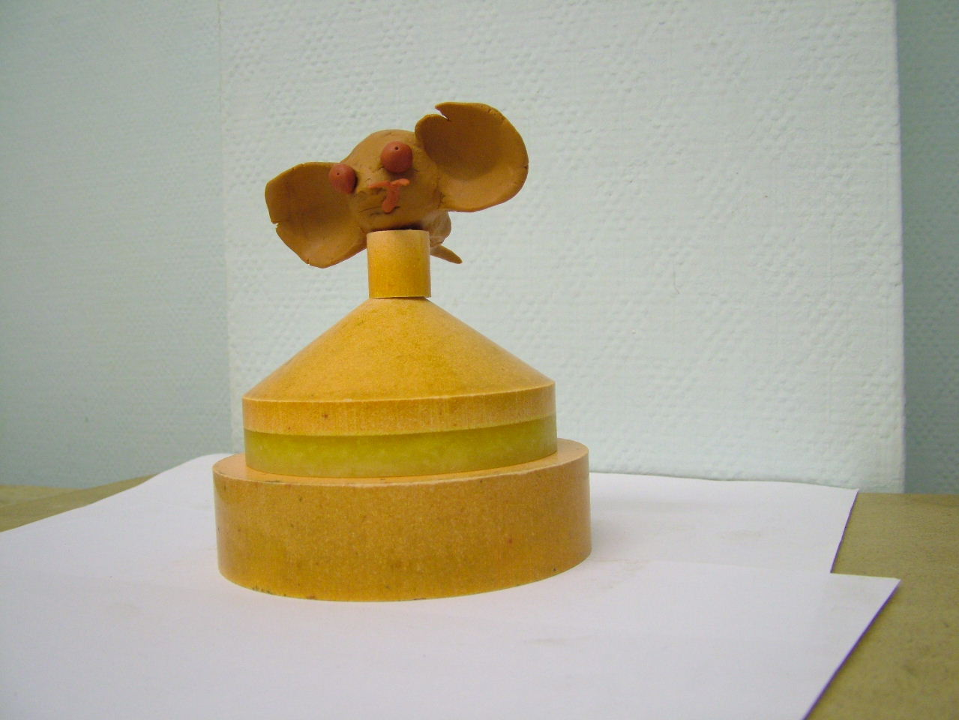
Thank you for your attention!

